Slide 1
Adham Ashraf Saeed
Assignment 5 (SQL)

Slide 2
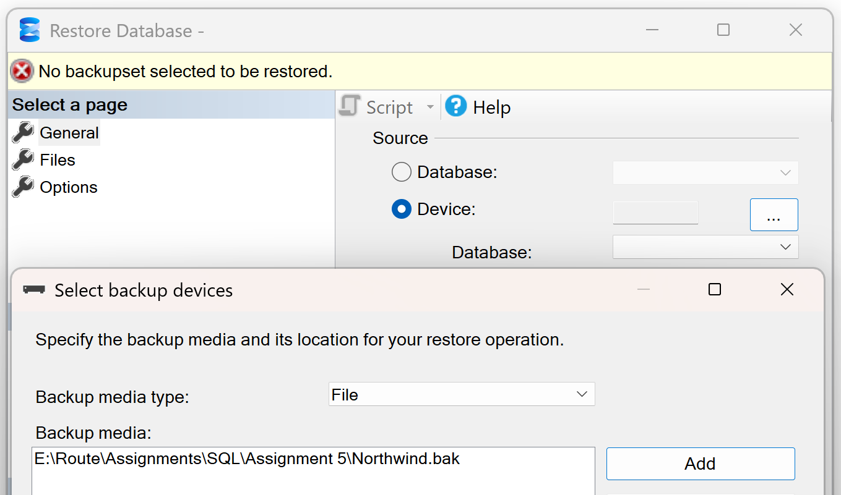
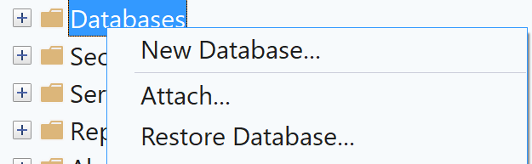

Load the provided dataset into your database
Open the provided links and download the dataset files
Northwind

Slide 3
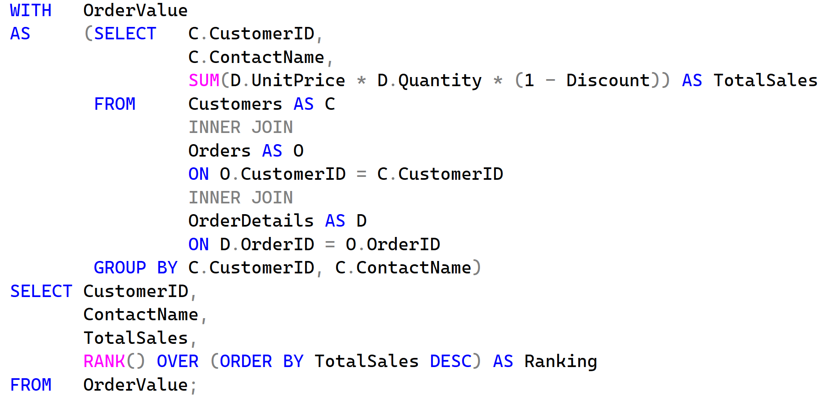
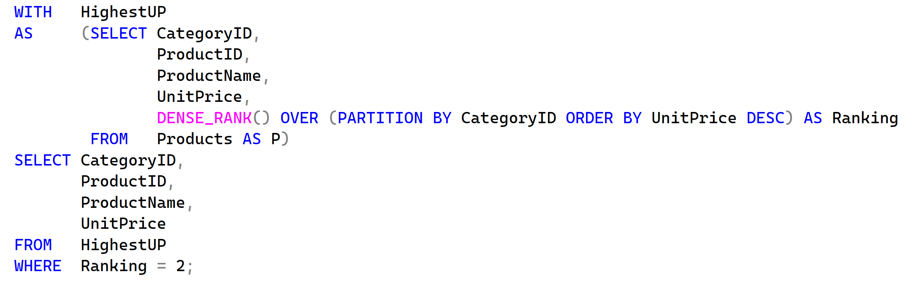
Questions
Write a query to rank each customer based on the total value of their orders, with 1 being the highest order value.
Write a query to find the second highest unit price of products in each category.

Slide 4
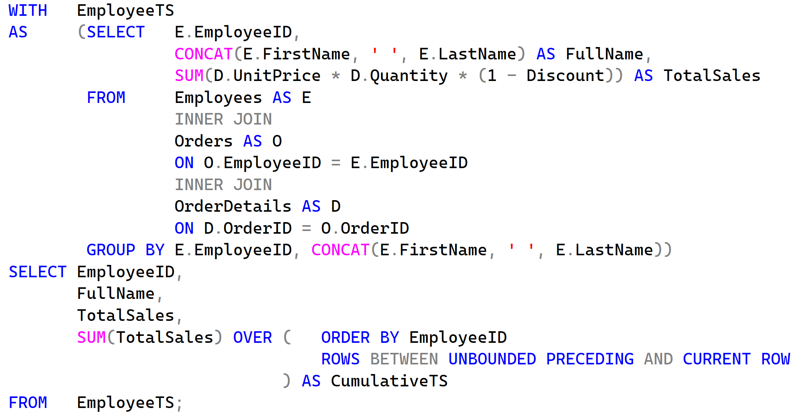
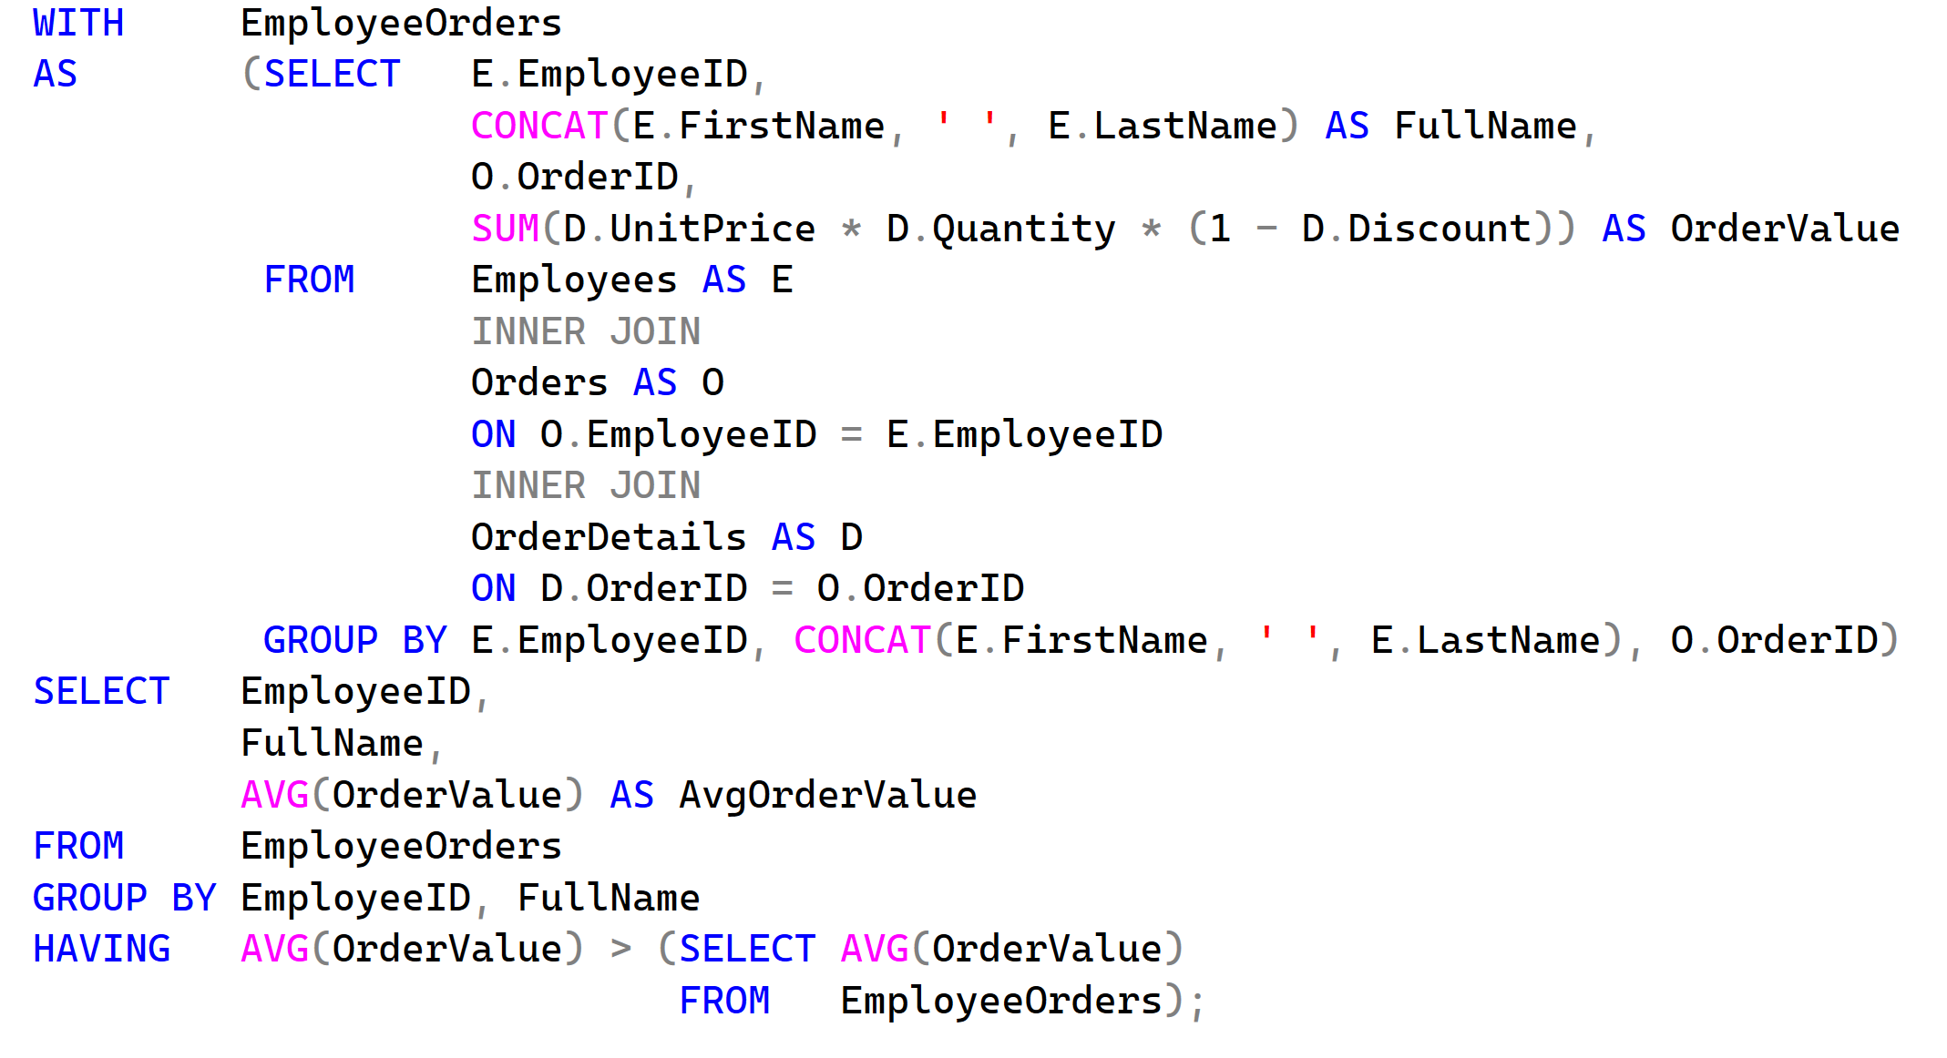
Questions
Write a query to calculate the total sales amount each employee made and include a running total (cumulative sum) of these sales
Write a query to find out the employees whose average order value is higher than the average order value of all employees.

Slide 5
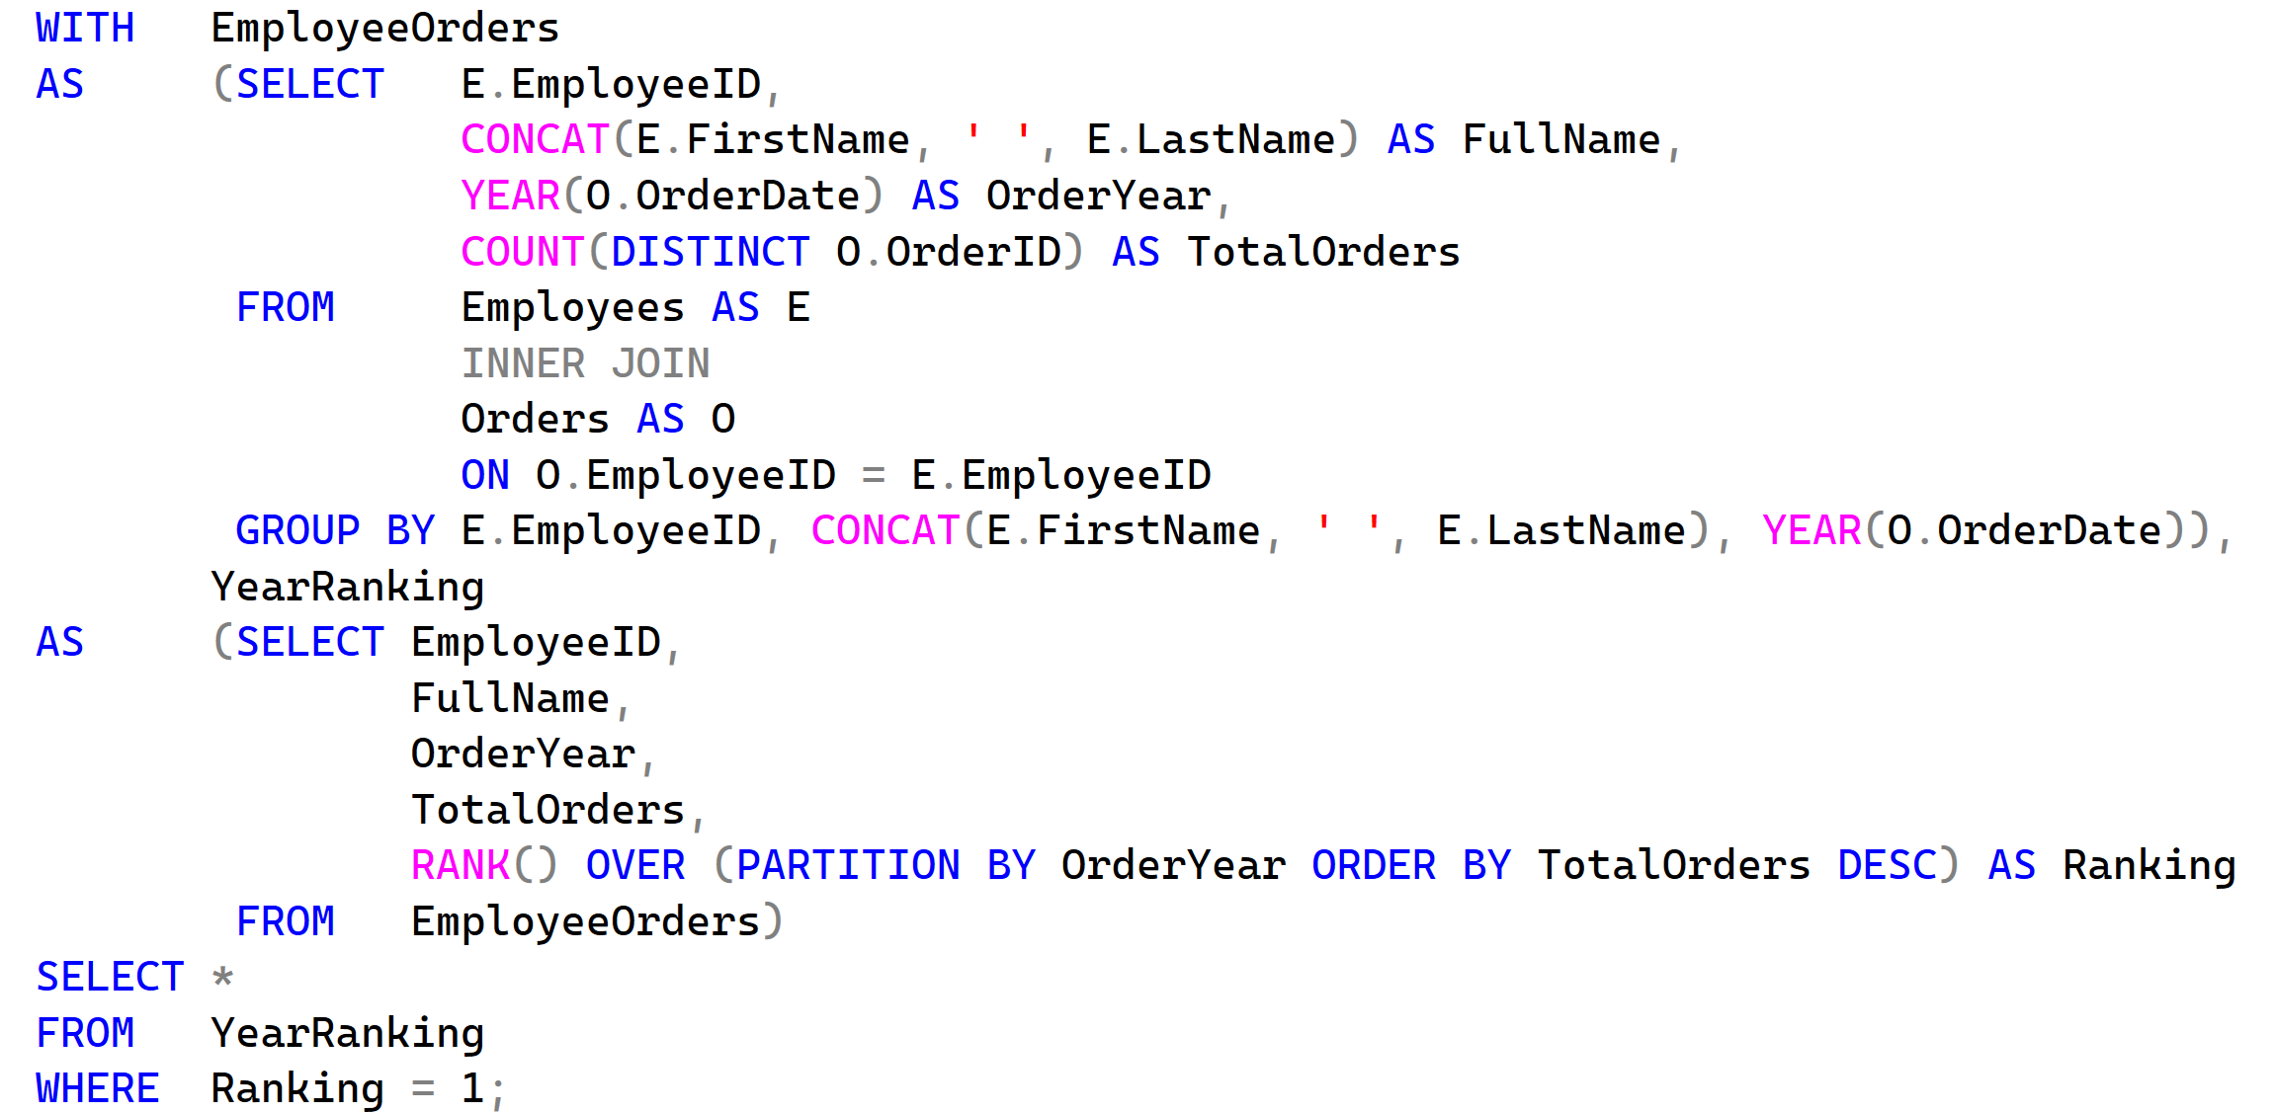
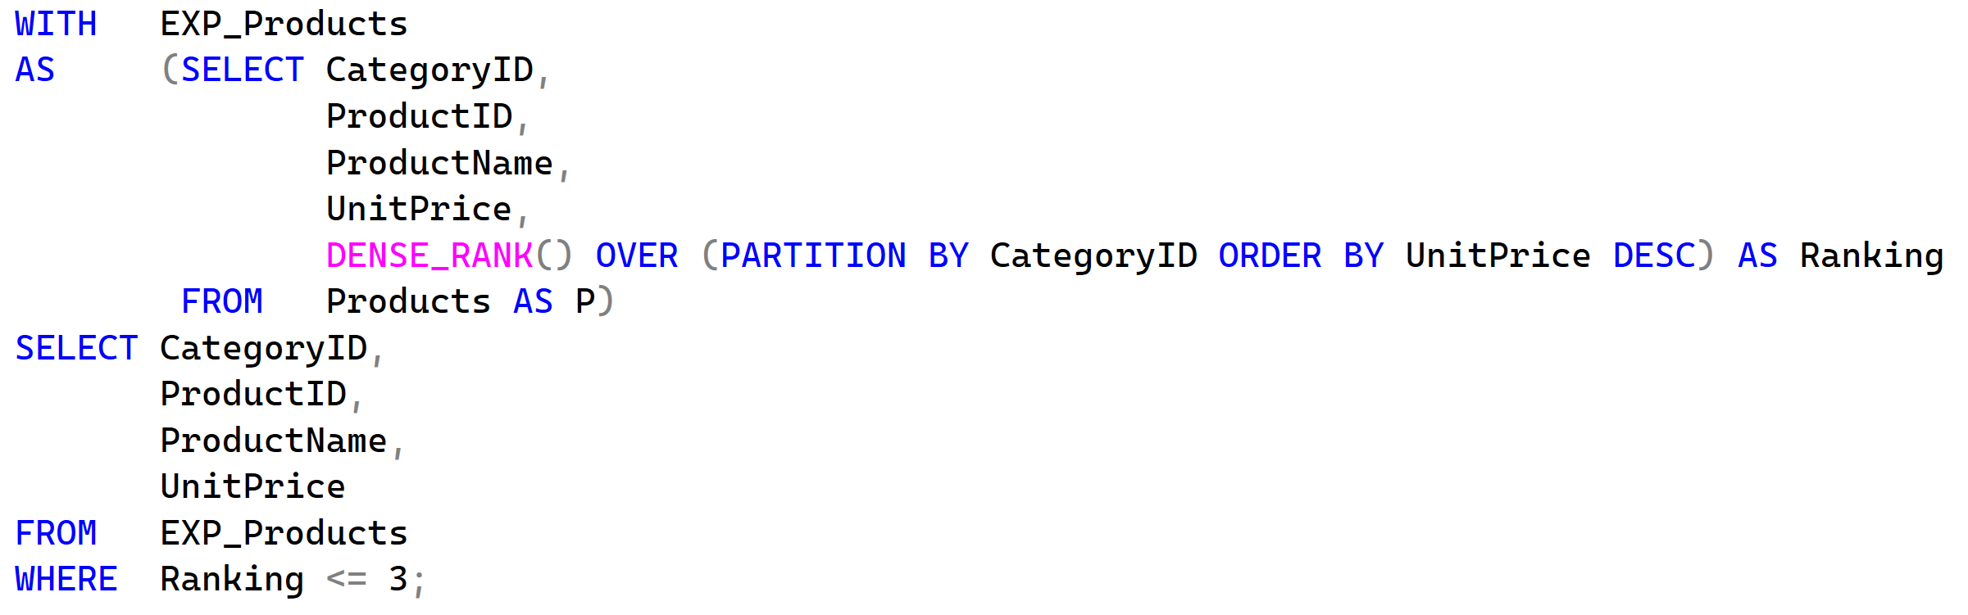
Questions
Write a query to find the employee who processed the most orders each year.
Write a query to find the top 3 most expensive products in each category.

Slide 6
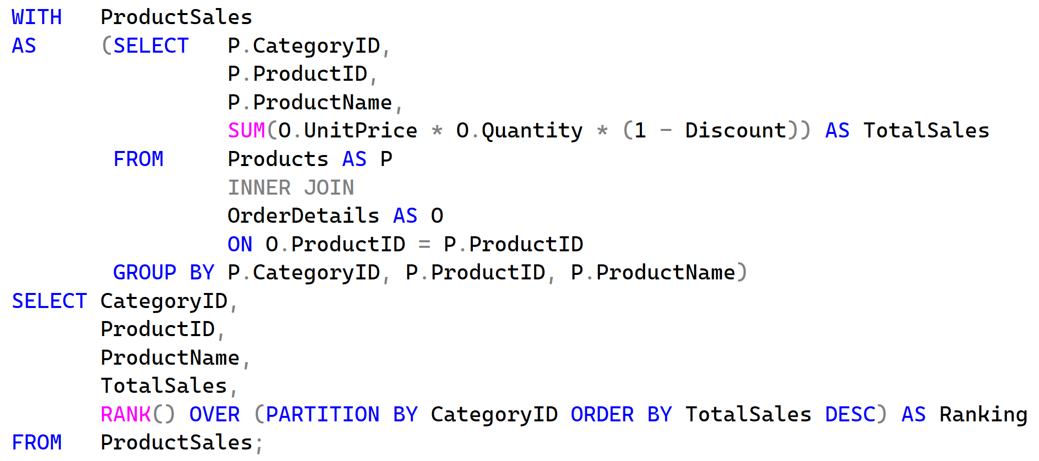
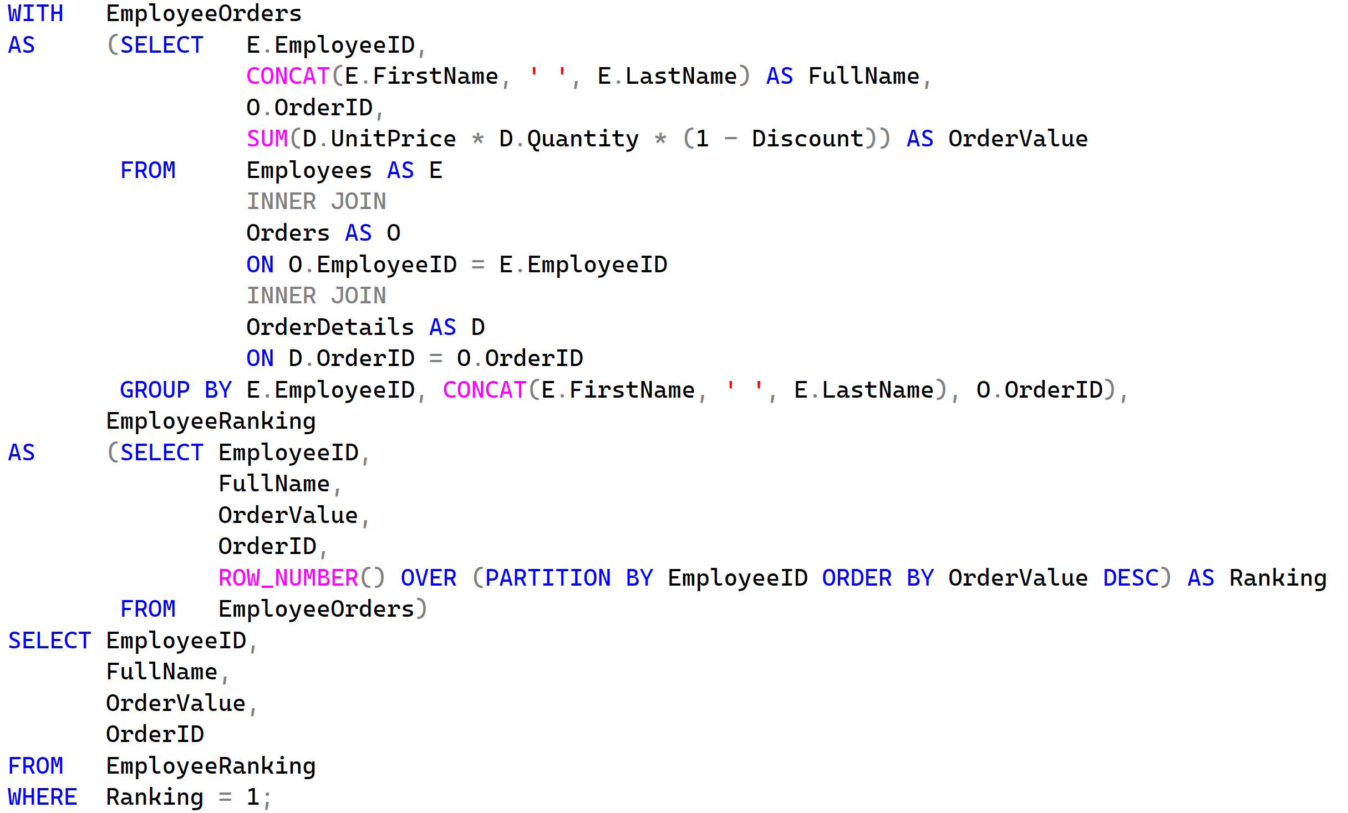
Questions
Rank products based on their total sales amount inside each category, with rank 1 being the highest-selling product per category.
Find the highest order value handled by each employee and return the corresponding order.

Slide 7
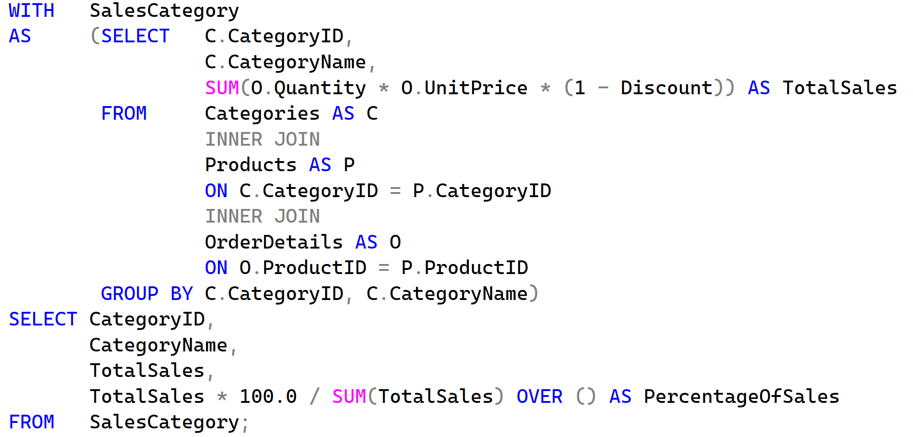
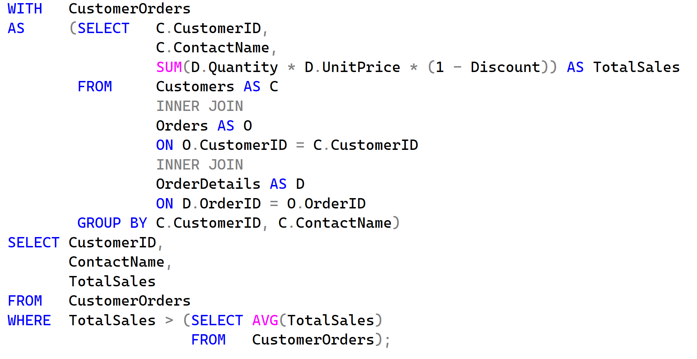
Questions
Calculate total sales per category and show each category’s percentage of total sales
Find customers whose total order value is above the average customer order value

Slide 8
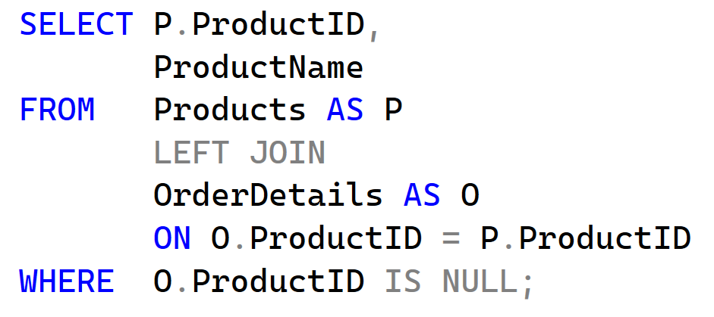
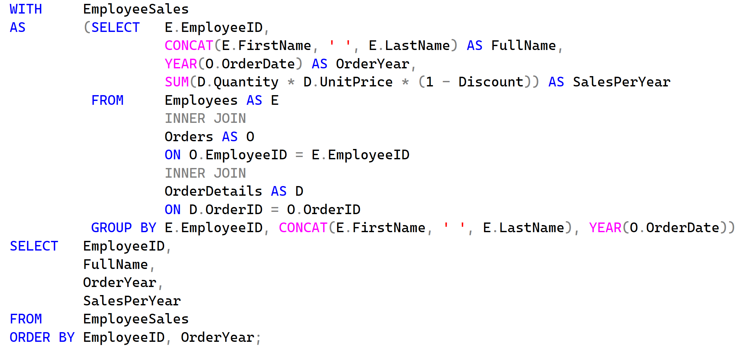
Questions
Find products that have never been ordered
For each employee, calculate total sales per year

